Slide 1
EDA Home Credit Case Study
-Prathyusha Josyula & Neelima Bhavanasi

Slide 2
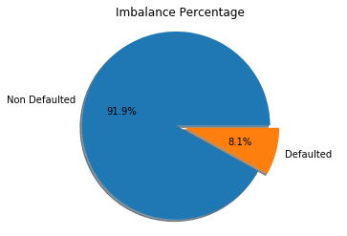
Imbalance Percentage…
The number of non defaulters vs defaulters gives the percentage imbalance of the dataset. The number of non defaulters being 91.9% and defaulters being 8.1% of the dataset ‘Application_data’.

Slide 3
EDA Univariate Analysis…

